Slide 1
Annual Interagency Accessibility Forum
Accessibility: A Foundation for Inclusion, Diversity, and Equity
October 12-14, 2021
Moving from Task-based Programs to a Safe, Accessible, Functional, Engaging (SAFE) Work-Life for Federal Staff with Disabilities
By Angie Fuoco, MPH, DrPH Candidate, Access & Abilities Evangelist

Slide 2
Purpose
I’m here in personal capacity sharing my views, not representing EPA.
I do not imply EPA sanction or endorsement of my views or materials.
Share ideas from my experiences:
Public health, safety, disability studies; ADA Coordinator; DEI field
Developing “disabling-for-a-time” level of hearing loss, mid-career
Offer ideas for:
Accessibility and disability communities
DEI (Diversity, Equity and Inclusion) community

Slide 3

Vision
Where there is no vision, the people perish… but people (who work in agencies) that keep the law are happy and blessed. - paraphrase, The Bible’s Proverbs 29:18
Law - meaning Rehabilitation Act and amendments!
Current and incoming employees will realize only their abilities at work, not their disabilities.
Everything that’s a policy or pathway, or that’s planned, produced, processed, put into place, paid for, passed along, or promoted is accessible.

Slide 4

Goals
Catch the Vision!
Challenge - model agency (Rehabilitation Act)
Celebrate its’ 50th Anniversary - Sep. 26, 2023
Create program framework that serves end users
Consider Accessibility its own unique part of DEIA E.O. 14035 - June 25, 2021, requires Strategic Plans
Consider concepts (systemic to small) to create a new program framework centered around end users

Slide 5
Definitions
Executive Order 14035 - 1-sentence definitions of diversity, equity, inclusion
Accessibility
92 words in two sentences
Included accommodations
Physical and digital spaces
Accessibility … easy to approach, reach, enter, speak with, use or understand – Dictionary.com
…people can do what they need to do in a similar amount of time and effort as someone that does not have a disability …people are empowered, can be independent, and will not be frustrated by something that is poorly designed or implemented. UK Government Blog

Slide 6
Discrimination - Definition and an Equation
Rehabilitation Act (and ADA) Definition of Disability Discrimination
Current
History or record
Perception of it, 6+ months, even if a person does not have one
Experientially-derived equation (not experimentally or empirically)
D Total = D Individual + D Policy & Practices + D Non-Compliance with standards & laws
(Other Protected DEI Characteristics) (Inaccessibility - only for Disability)

Slide 7
Disability vs. Other Protected Characteristics
Unasked-for Change - disability change brings chaos!
Most disability happens on the job vs. Schedule A hires.
Function - other protected characteristics do not function affect directly
Other protected characteristics do not have services specified in law
Lack of coordination of those services at work brings more chaos!

Slide 8
Who Do I Need to Talk to about My Disability?
Civil Rights Office or the EEO
Can I just phone a friend?
Facilities
EAP
Safety Office
Emergency Floor Coordinator
Reasonable Accommodation
Training Officer
Is there an App for this? Handbook? Webpage?
Supervisor
National Disability Program Manager
Section 508
Security
Human Resources

Slide 9

SAFE at Work
Safety, both physically and psychologically
Accessibility - workplace / human right, needs to be 100% all the time
Functional - “systems serving staff with disabilities - to be functional”
Engage all - build program by and with physically, neuro- and psychologically-diverse people
Neurodiversity - range of differences in individual brain function and behavioral traits, regarded as part of normal variation in the human population - Judy Singer (see reference)
Psychological Diversity - differences in underlying attributes of team members, including human features like skills, abilities, personality characteristics, and attitudes - Landy and Conte, 2004 (see reference)

Slide 10
Safety - Obligations and Considerations
Obligation - Physical, 29 CFR 1960 - occupational safety and health programs for agencies
Consideration - free from recognized hazards… likely to cause death or… serious physical harm
Prevention - Safety can work differently when a person has a disability
RETAIN Initiative - return to work after injury or illness that causes disability
Other Considerations
Customized Employment - personalizing the job (people with disabilities and veterans)
Psychological safety is for everyone (Ted Talk, 2014). “The belief that one will not be punished or humiliated for speaking up with ideas, concerns, questions, or mistakes” and also, Dr. Edmonson (Psychology Today, 2021) “an environment in which people believe they can speak up candidly with ideas, questions, concerns, and even mistakes, is vital to leveraging the benefits of diversity, because it can help make inclusion a reality” and (Harvard Business Review. 2021).

Slide 11
Accessibility - Observations
History of disability law (according to the Colorado State University’s Student Disability Center)- “providing vocational opportunities” has evolved into the concept of “equal rights and access”
Rehabilitation Act of 1973 - “rehabilitation of handicapped individuals so they could work”
Accessibility is evolving with E.O. definition and is just now getting a seat at the DEI table
Architectural barriers should be thing of the past, now focus on maintenance and safety
Increase in scope of disabilities and emerging disabilities (such as Long Covid)
Federal government usually lags behind corporate innovation

Slide 12
Accessibility - Recommendations
Amp up Awareness
Ableism, Audism, attention to terms used and all forms of Disability Discrimination (in equation)
Accessibility (E.O. specifies “knowledge of” for all staff; include accessibility “action” training also)
Annual/onboarding training - all are responsible, train in varying degrees
Add Access Pathways - don’t substitute or it ends up being subtraction for so many of us
Assess and test emerging technology or methods - examples: don’t stay stuck in “CART”
consider: hybrid AI captions, captions in Glass, captions in a staff member’s pocket
Analysis, assessment of needs, asking customers their satisfaction levels
Actionable Plan - 5,000 to 0 (presentation given now in another session)
Accountability - E.O. 14035 says Chief Diversity Officer, Accessibility Officer?

Slide 13
Functional - Observations
Observations at several federal agencies - not functional for achieving Vision
1973 - Rehabilitation Act did not specify an official to oversee persons with disabilities program
2000s - agencies hired first disability program managers and Section 508 program managers
Specific service lines (“silos”) - remember the 13 distinct offices for people with responsibilities
“Tokenizing”? Competence learned on-the-job?

Slide 14
Functional - Recommendations
Recommended for the model agencies
Accessibility (or Rehab Act?) Officer, models: ADA Coordinator, Vocational-Rehab Counselor
Establish competencies for Accessibility Officer? Physical, neuro-, psychologically conversant
Invest in someone other than Chief Diversity Officer - Authority and Accountability for people!
Look within before looking without at outside leadership + knowledge, skills, abilities of staff
Need strategic thinking away from the silos! Plan changes with continued functionality in mind.

Slide 15
Engaging - Obligations and Considerations
Obligations for Engagement - none formal
Considerations
Engage staff with disabilities in creating strategic plans and new program framework
Equity - from E.O, “consistent and systematic fair, just, and impartial treatment of all”
Empathy - staff being hired in this area need to know about disabilities and accessibility
Evaluate for effectiveness (develop customer satisfaction metrics, not just the numbers of Schedule A hires and accommodations)
Employee Viewpoint Survey (EVS) - opportunity for accessibility satisfaction measures

Slide 16
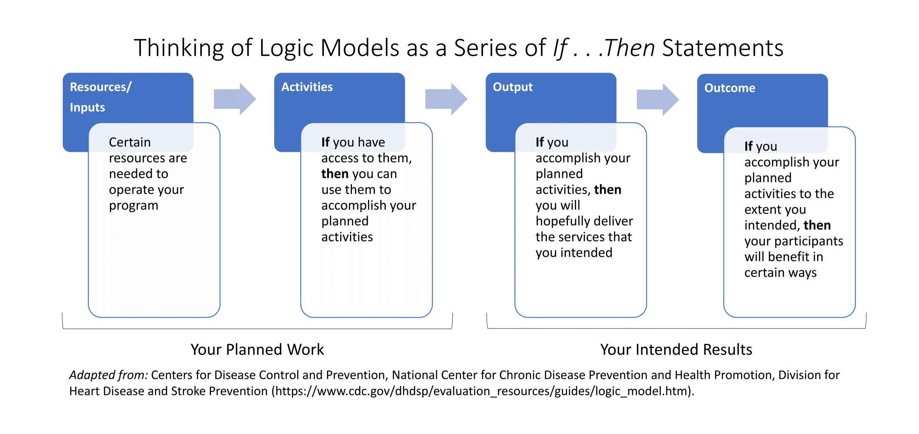
Use a Logic Model to Develop Program and Plan
https://www.cdc.gov/tb/programs/evaluation/Logic_Model.html

Slide 17
PAUSE Principles
Derived from WCAG 2.1 POUR Principles
(https://www.w3.org/TR/UNDERSTANDING-WCAG20/intro.html) and SAMHSA’s (HHS) eight wellness dimensions.
The eight domains of wellness include:
- occupational
- physical
- emotional
- social
- intellectual
- financial
- spiritual
- environmental
https://www.youtube.com/watch?v=tDzQdRvLAfM (July 1, 2016, SAMHSA Wellness Initiative).

Slide 18
Model Federal Program for People with Disabilities
Creating a Model Agency EEO Program - Disabilities Employment Program
https://www.eeoc.gov/federal-sector/management-directive/instructions-federal-agencies-md-715-section-i-model-eeo#:~:text=The%20six%20essential%20elements%20for%20a%20model%20EEO,prevention%20of%20unlawful%20discrimination%3B%20Responsiveness%20and%20legal%20compliance
Added disability-specific law to template - section 501/504/508 requirements (it’s still a two-pager).

Slide 19
References
Ajmera, S. (2021, July). Psychological diversity - The future solution to inclusiveness! [Image attached] [Post]. LinkedIn. https://www.linkedin.com/pulse/psychological-diversity-future-solution-sneh-ajmera-and. Accessed September 24, 2021
Edmonson, A. Building a psychologically safe workplace | Amy Edmondson | TEDxHGSE (2018, May 4). https://www.youtube.com/watch?v=LhoLuui9gX8. Accessed: September 24, 2021
Edmonson, A. (2020, June 22). The Role of Psychological Safety in Diversity and Inclusion. Psychology Today. www.psychologytoday.com/us/blog/the-fearless-organization/202006/the-role-psychological-safety-in-diversity-and-inclusion. Accessed: September 24, 2021.
Edmonson, A. Mortenson, M. (2021, April 19). What Psychological Safety Looks Like in a Hybrid Workplace. Harvard Business Review. https://hbr.org/2021/04/what-psychological-safety-looks-like-in-a-hybrid-workplace. Accessed: September 24, 2021.
Landy, F. and Conte, J. Work in the 21st Century: An Introduction to Industrial and Organizational Psychology. McGraw-Hill. 2003. {Psychological Safety defined}
Singer, J. “Why Can’t You be Normal for Once in Your Life? Disability Discourse, Marian Corker Ed., Open University Press. 1999. {Neurodiversity defined}

Slide 20
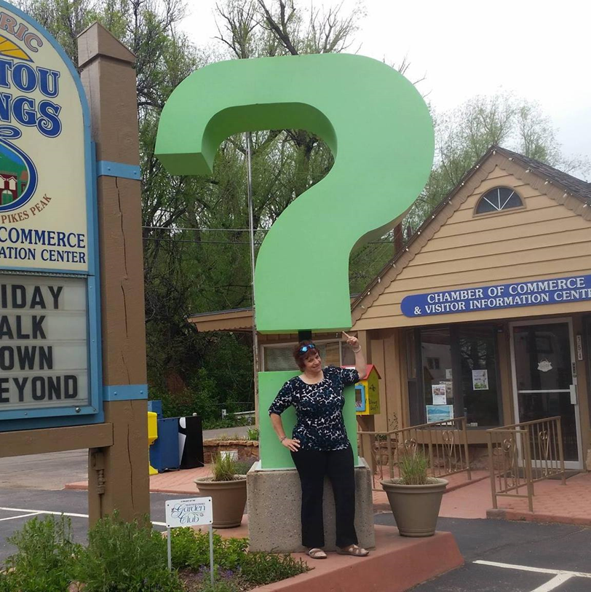
Questions, Remarks, Rebuttals, Reproofs…
Accessibility - foundational for the health and wellness of staff with disabilities and the public that we serve.
angiefugo@yahoo.com for more information or to share:
PAUSE Principles
Model EEO - People with Disabilities
how we can partner to do research…

